Slide 1

“Enhancing Tourist Experience through Spatial Analysis of Accommodations and Food & Drink Places in Australia”
CS621C[A] Final Project

Slide 2
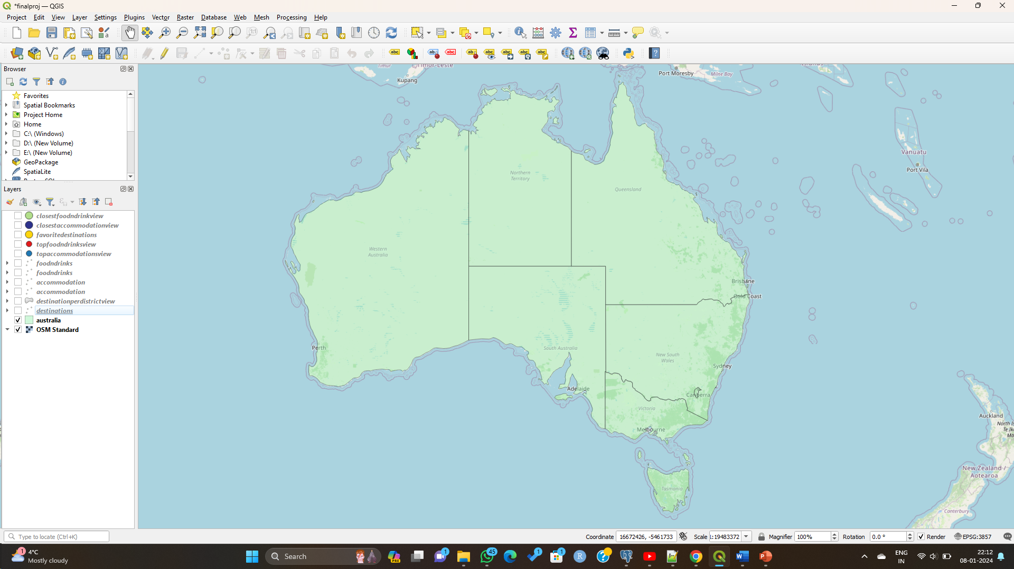
My GeoSpatial Story
Australian Tourism Significance
Australia's tourism industry is a vital component of its economy, contributing significantly to its GDP and creating employment opportunities across various sectors.
The country's diverse and stunning landscapes, unique wildlife, vibrant cities, and rich cultural heritage attract millions of international and domestic tourists each year.
The tourism sector not only fosters economic growth but also plays a crucial role in promoting cultural exchange, fostering global understanding, and showcasing Australia as a desirable travel destination on the world stage.

Slide 3
Scope of the Project
The project aims to analyze and enhance the tourist experience in Australia by focusing on three key datasets: Destinations, Accommodations, and Food & Drink Places. Through spatial analysis in QGIS, the project will investigate the distribution and characteristics of accommodations and dining options in Australia. The scope includes:
Spatial Analysis: Utilize Geographic Information System (GIS) tools to visualize and analyze the geographical dispersion of destinations, accommodations and food & drink places across Australian districts.
Tourist Decision-Making: Explore factors influencing tourist choices, emphasizing the importance of proximity to destinations and diverse dining options.
Accommodation Analysis: Examine the distribution of accommodations based on types (Chalet, GuestHouse, Hostel etc) and their proximity to tourist destinations.
Food & Drink Places Analysis: Investigate the dispersion of food and drink places based on types (Pub, Cafe, Restaurant) and their correlation with popular tourist destinations.
User Preferences: Consider user preferences by incorporating ratings into the analysis, enabling tourists to make informed decisions aligned with their preferences.
The project seeks to contribute valuable insights for tourists, businesses, and policymakers, ultimately fostering sustainable tourism practices and enhancing Australia's position as a premier travel destination.

Slide 4
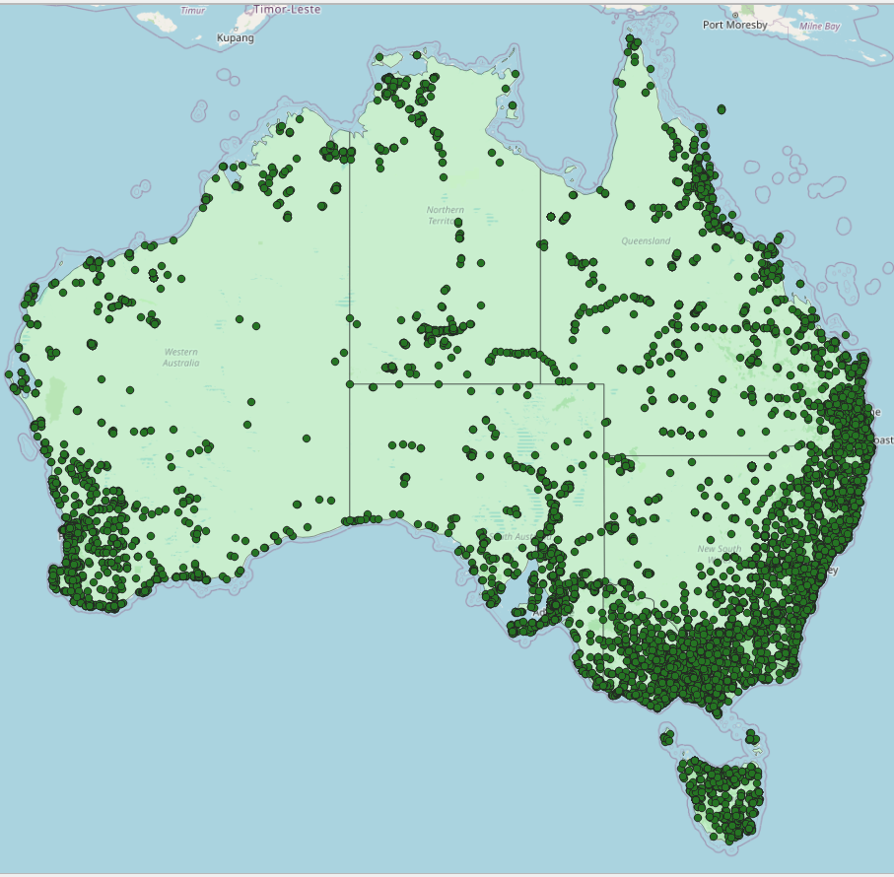
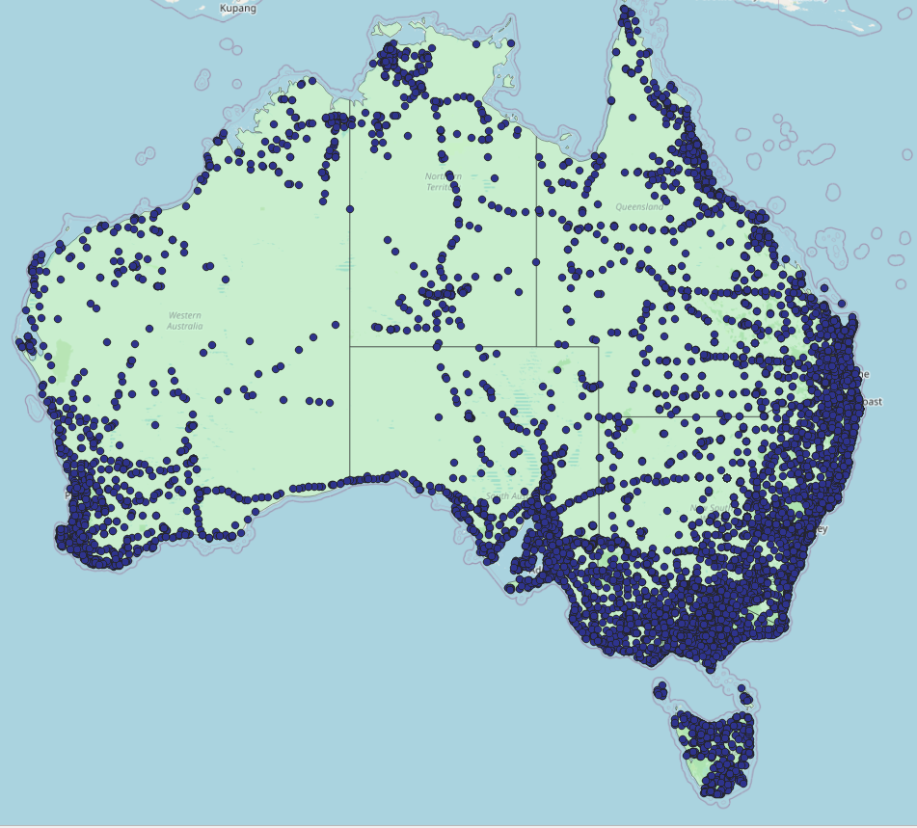
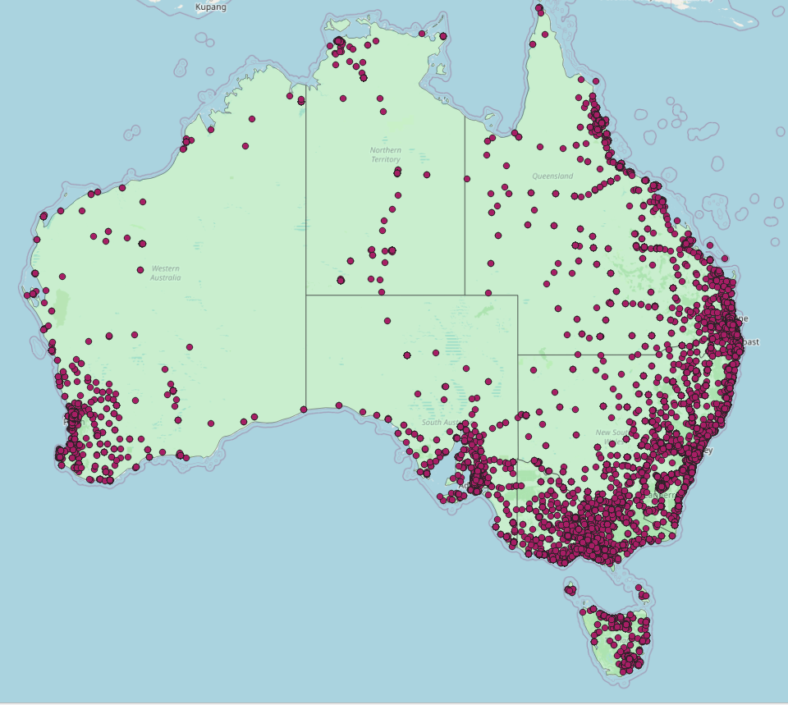
Dataset Visualization.
Destination Accommodation Food & Drinks

Slide 5
Closing Remark
The visualizations vividly depict a clustering of accommodations and dining options around destinations, underscoring the strategic placement of services to cater to the influx of tourists.
Australia's wealth of destinations within each district provides an extensive array of choices for the discerning traveler. The multitude of destination categories, accommodation types, and dining options showcase the country's commitment to offering a rich and varied experience to its visitors.
Remarkably, the high ratings across accommodations and dining establishments reflect the commitment to quality in Australia's tourism sector.
In summary, our analysis affirms that Australia's focus on tourism extends beyond mere hospitality—it is an immersive and well-crafted experience.

Slide 6

ThankYou.

